Slide 1


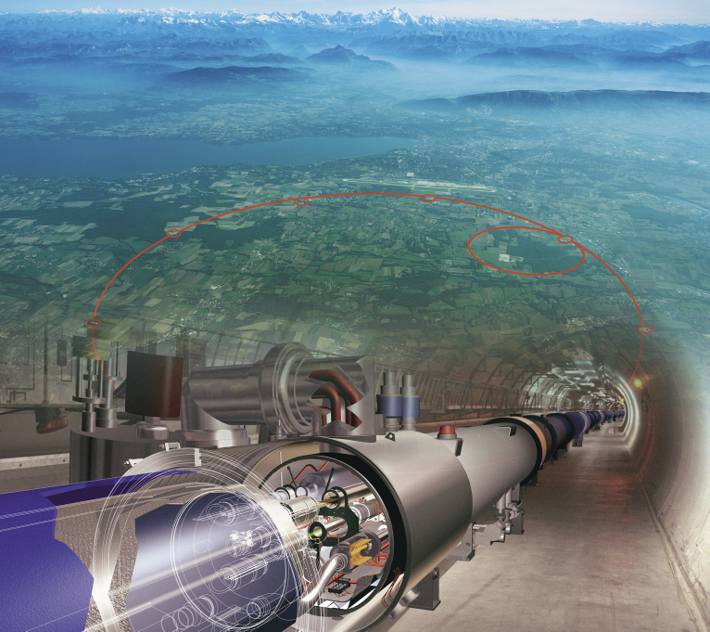
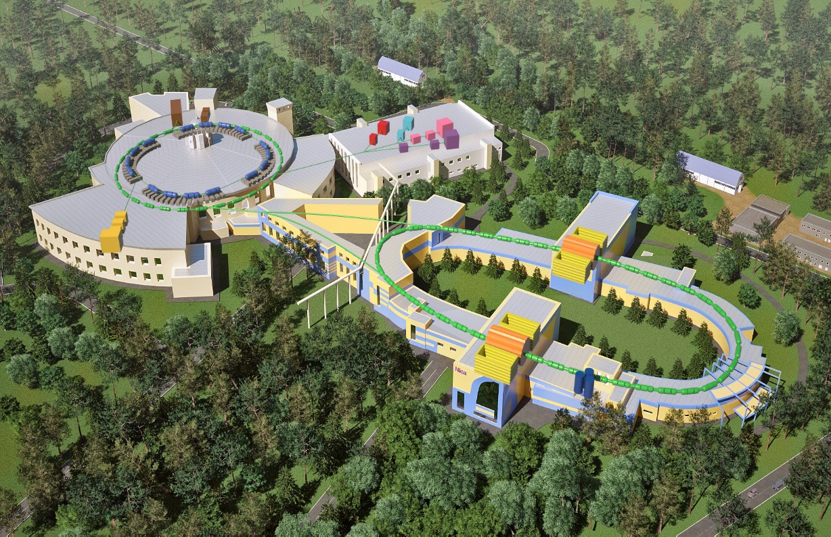
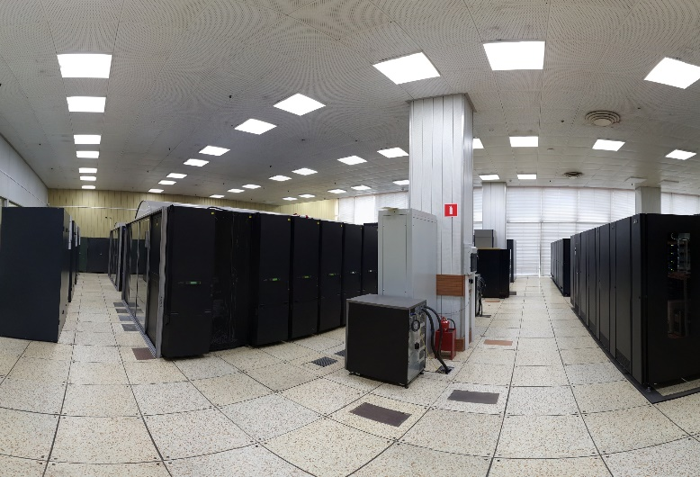
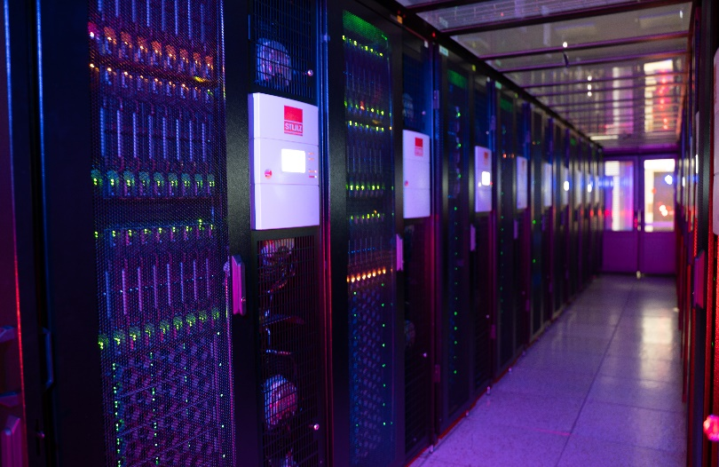
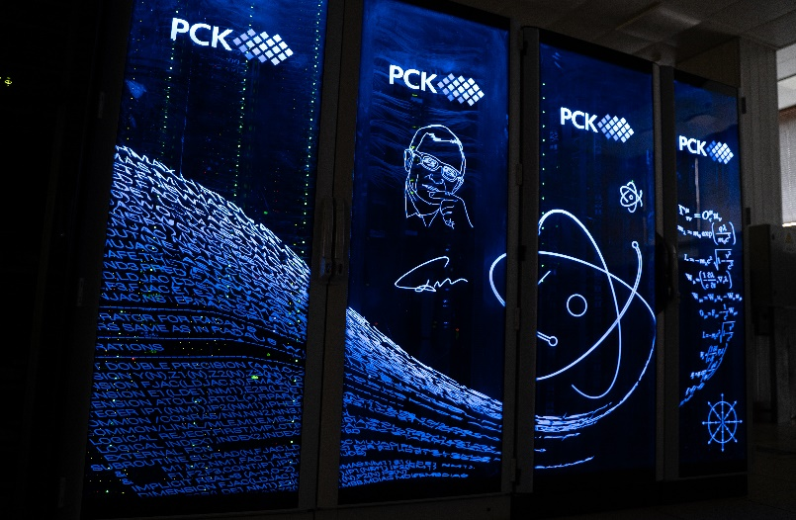
Computing in High Energy Physics
Sergei Shmatov (MLIT JINR, Dubna)
shmatov@jinr.ru shmatov@cern.ch
MLIT, JINR, Dubna
16-20 October, 2023
MLIT, JINR, Dubna
7 October, 2024
MLIT, JINR, Dubna
7 October, 2024

Slide 2
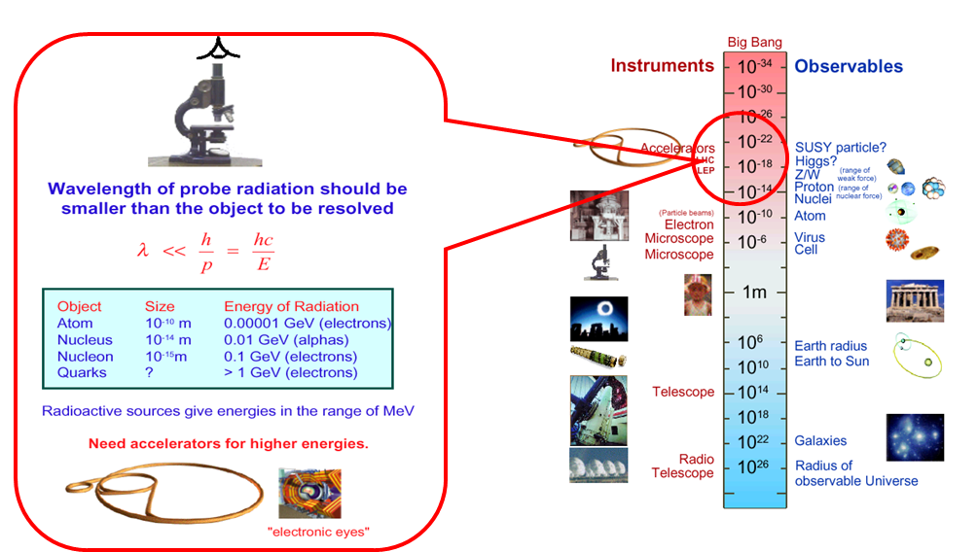
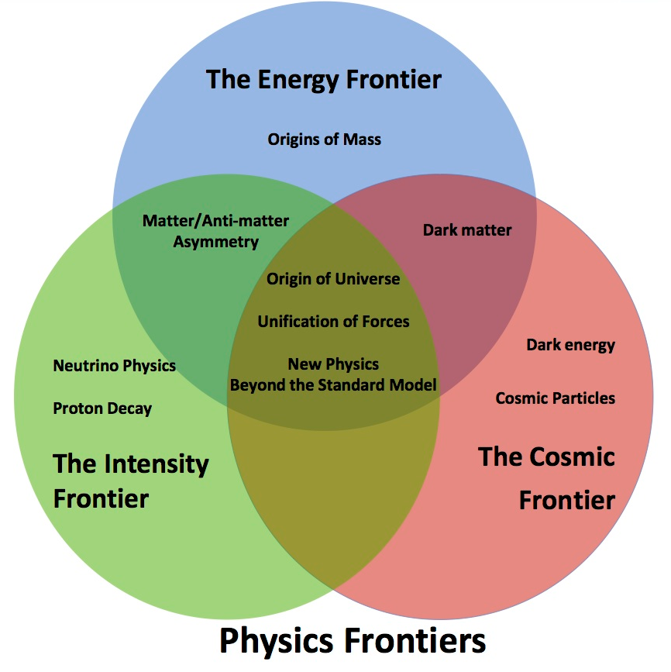
What Do Particle Physicists Do?
People have long asked,
"What is the world made of?”
"What holds it together?”
Physicists hope to fill in their answers to these questions through the analysis of data from High Energy Physics experiments
Some eternal questions
Particle physics have focused on the inner space frontier, pursuing the questions of the construction of matter and the fundamental forces at the smallest scale accessible.

Slide 3
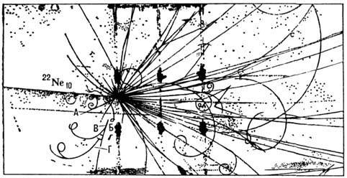
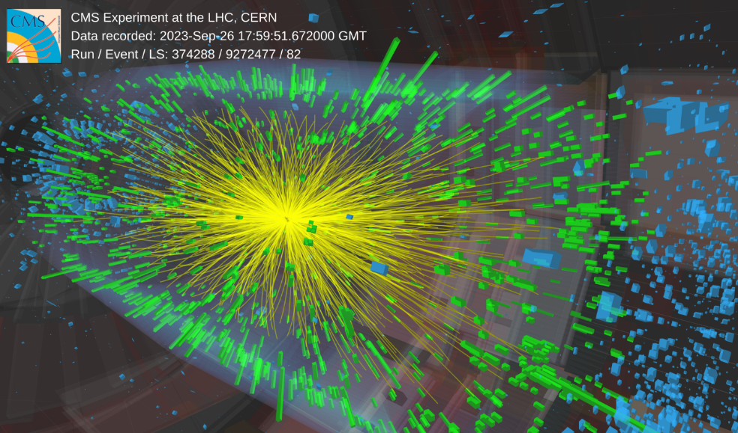
Do Physicists Really Need Computers?
Computing is any goal-oriented activity requiring, benefiting from, or creating computing machinery (c) Wiki
general-purposed devices (computers/laptops/mobile..) and software
dedicated tools
Bubble chamber, Synchrophasotron (JINR),
²²Ne (p=92,4 ГэВ/с) + Та
50 particles
only one photo per second
CMS @ LHC, PbPb (5,5 TeV), RUN3
thousands particles
140 million electronic channels
3-dimensional “camera” able to shot 40 million “pictures” per second

Slide 4
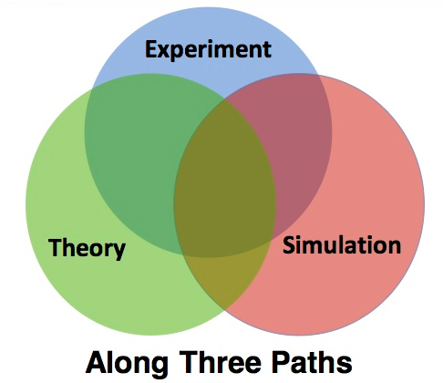
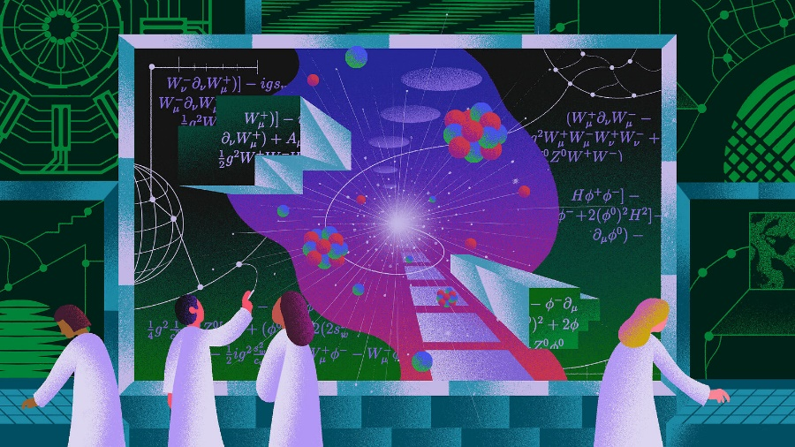
Particle Physics Tools
Particle physics or high energy physics is the study of fundamental particles and forces that constitute matter (c) Wiki
Where can I get elementary particles?
in Nature (cosmic sources, earth sources, i.e. natural radioactivity)
man-made sources (reactors, accelerators)
How can you catch particles ⇒ detector facilities
What is needed for data processing?
algorithms and software for reconstruction of
physics objects and processes
What is needed for data analysis?
Theory
Monte Carlo Tools
Statistics Tools
Information Technologies

Slide 5
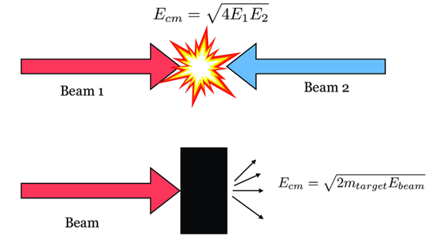
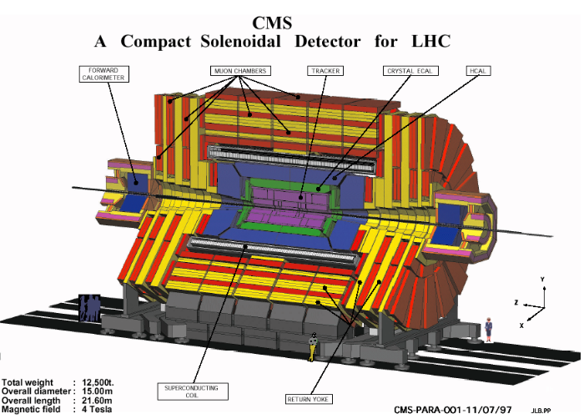
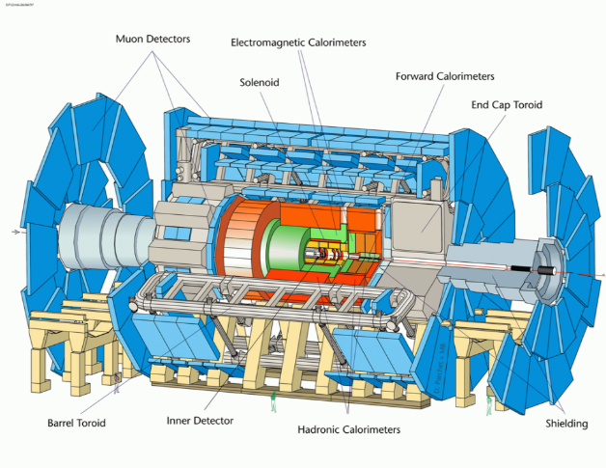
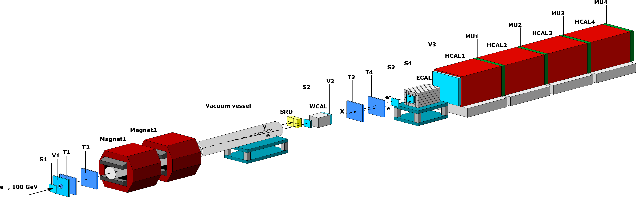
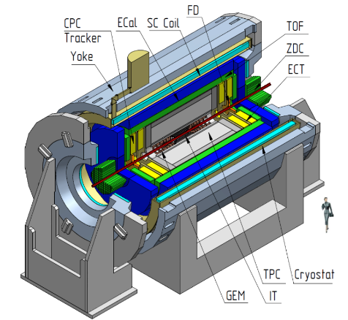
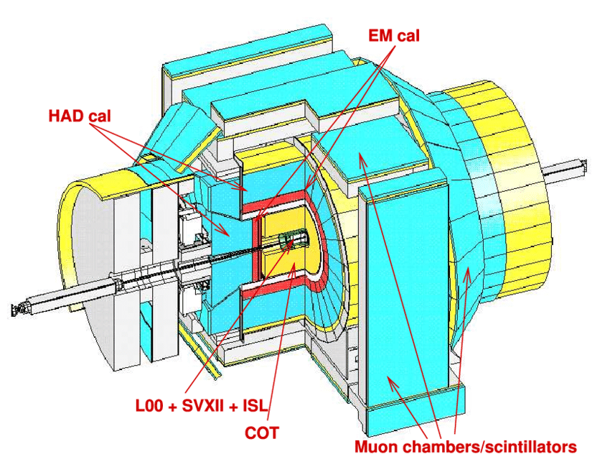
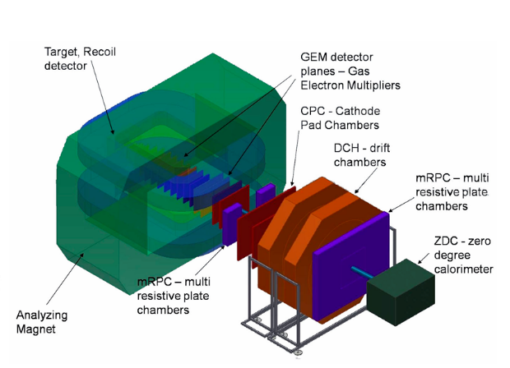
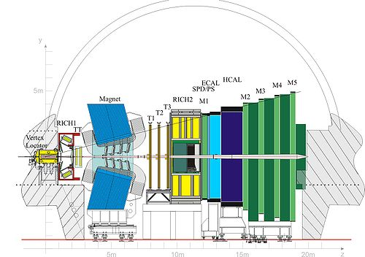
Examples of Experimental Facilities
CMS (LHC, CERN)
ATLAS (LHC, CERN)
NA64 (SPS, CERN)
MPD (NICA, JINR)
CDF (Tevatron, FLab)
BM@N (NICA, JINR)
LHC-B (LHC, CERN)
Scale without preservation of proportions

Slide 6
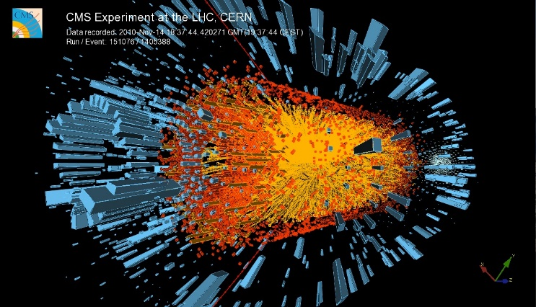
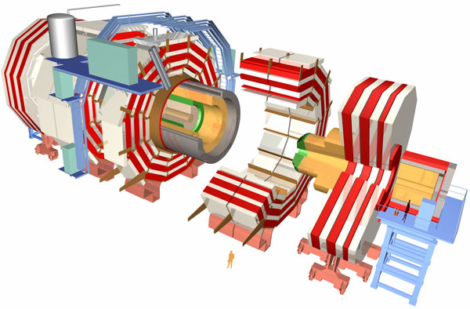
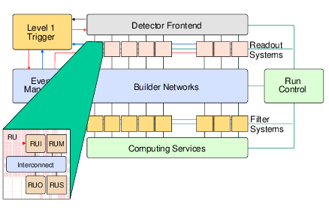
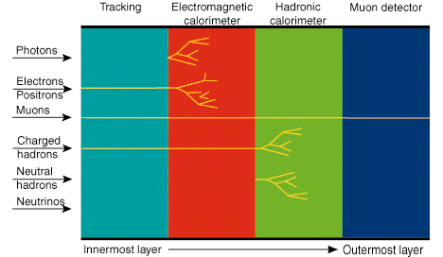
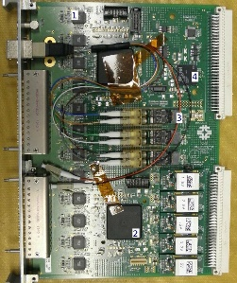
Workflow in Detectors
LHC Collisions
Interactions with
detector elements
Readout of detector electronics

Slide 7

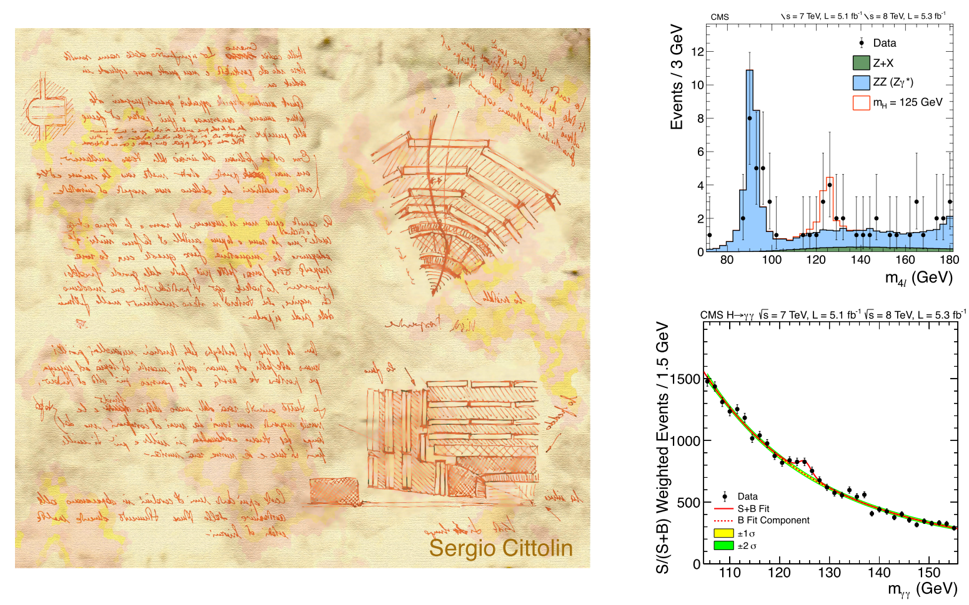
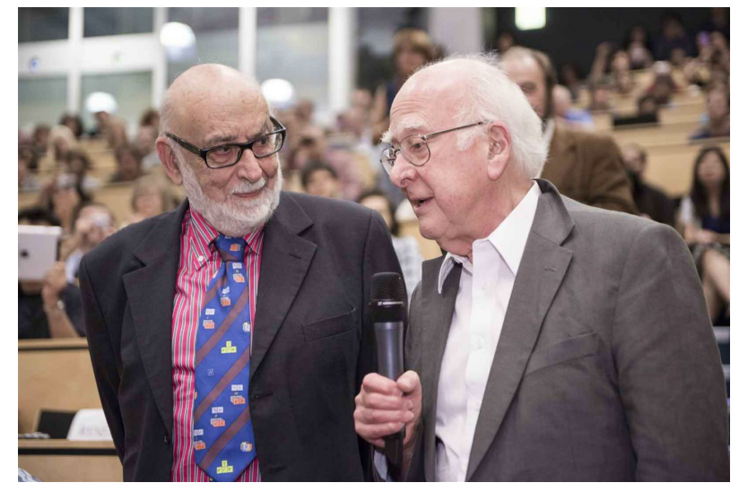
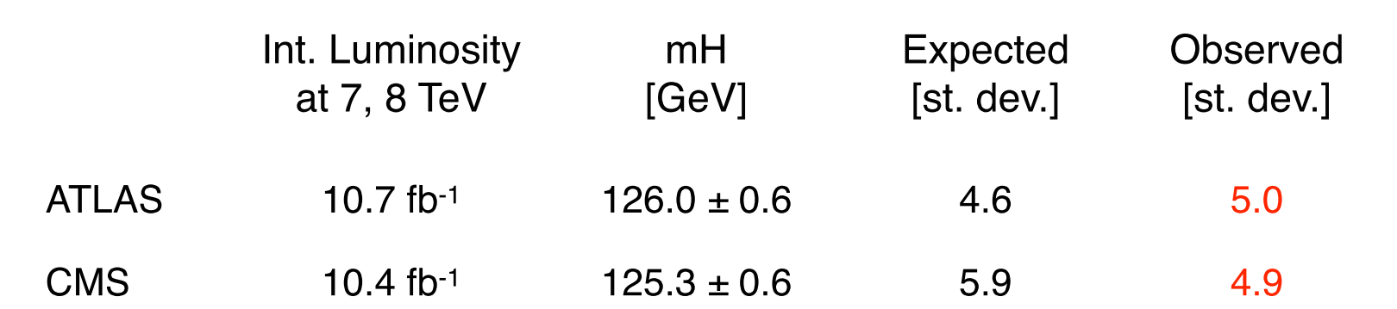
What do physicist want to see?
Higss Boson
From design
to discovery
4 July 2012
Higgs announcement at CERN

Slide 8
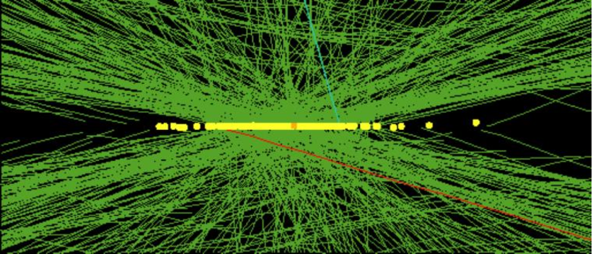
What do they actually see?
Real CMS Event with High Pile-up
High pileup event with 78 reconstructed vertices taken in 2012 by CMS

Slide 9

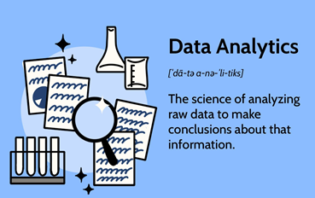
What is happening and and what we can do about it…
Physics objects
Event Selection
Reconstruction and Processing
Data Analysis

Slide 10
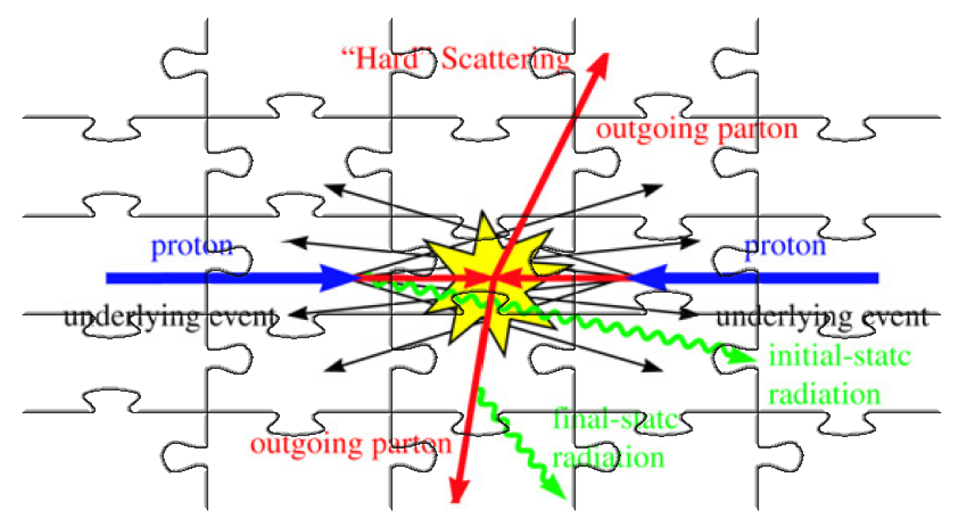
Mosaic of Collisions

Slide 11
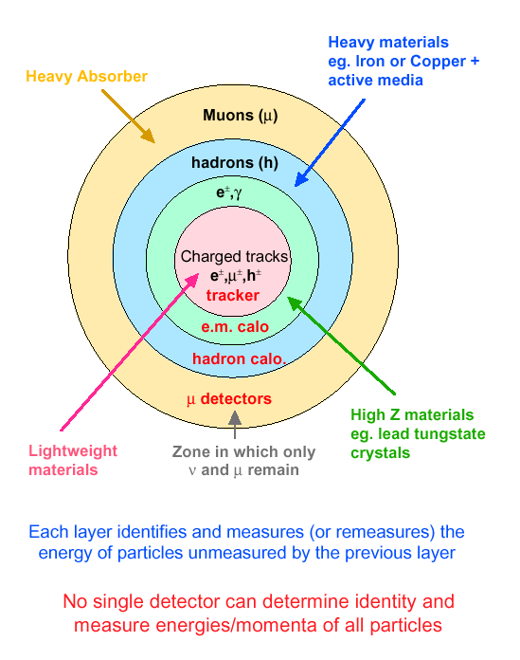
Modus Operandi for Experiments
Onion structure of detector layers placed in B-field

Slide 12

Event Selection and Data Flow

Slide 13
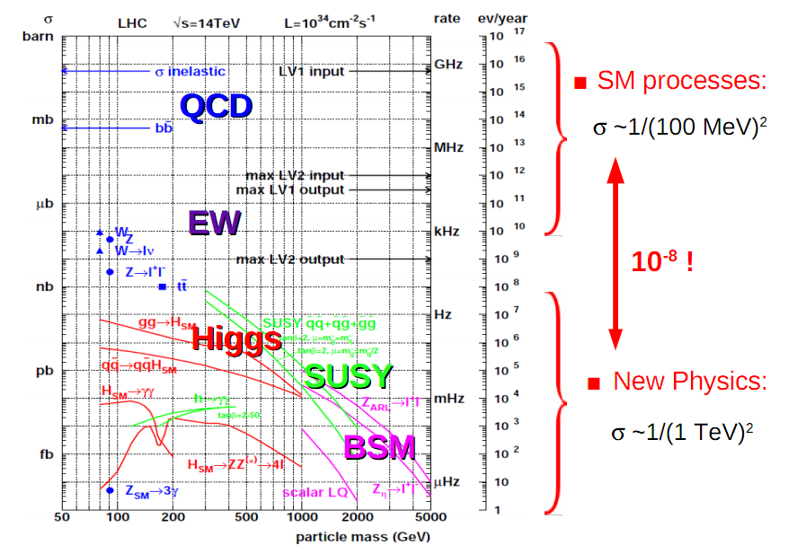
Physics Processes at LHC

Slide 14
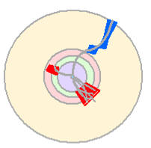

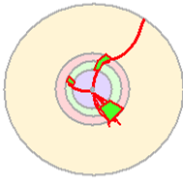
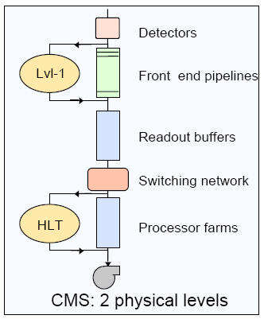
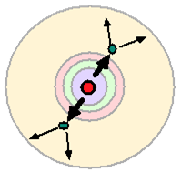
Multi-Layer Selection and Triggering
Level-1:
Hardware selection is comprised
of custom electronics that process
data from detectors, rough cutoffs
High Level Trigger:
Software selection based on
reconstruction of physics objects,
event topology

Slide 15
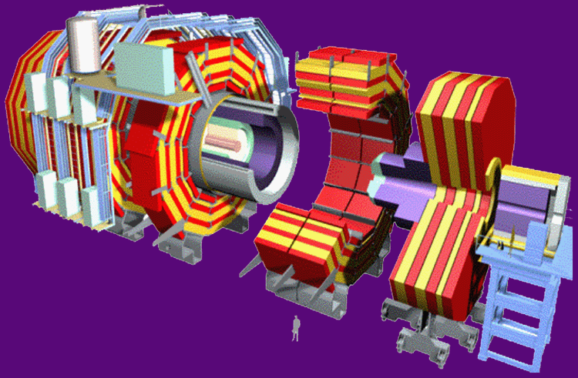
Trigger Rates
40 MHz (1000 TB/sec)
Level 1 - Special Hardware
75 KHz (75 GB/sec)
Level 2 - Embedded Processors
5 KHz (5 GB/sec)
Level 3 – Farm of commodity CPUs
100 Hz (100 MB/sec)
Data Recording &
Offline Analysis

Slide 16
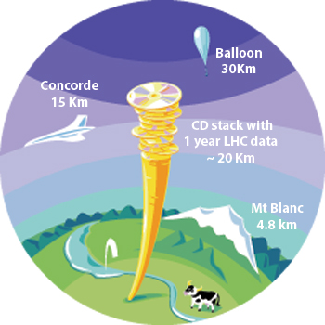
Data Flows
~ 3PB/year
~ 3PB/year
Big Data/GRID Computing

Slide 17
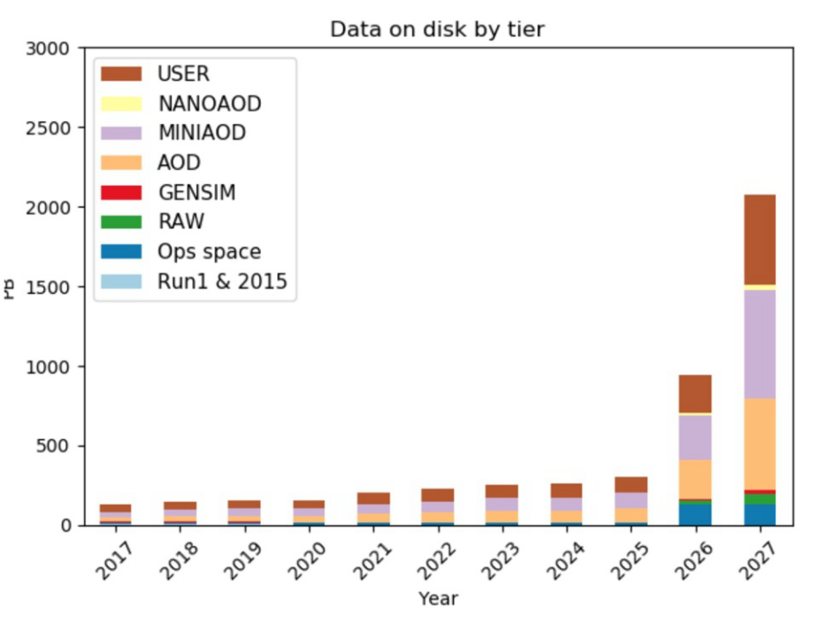
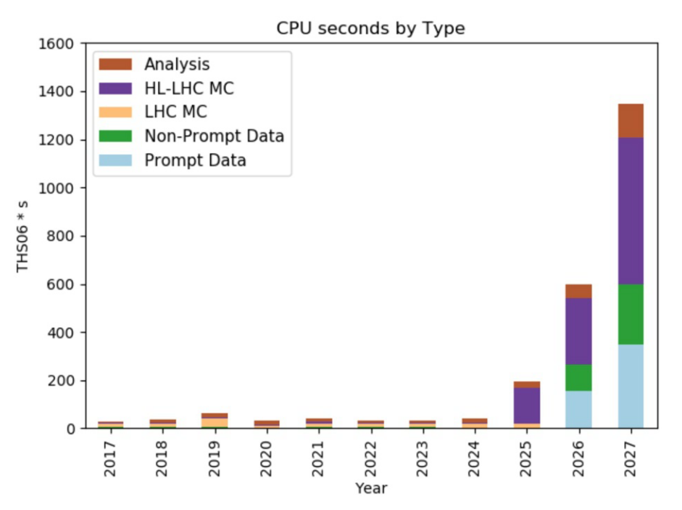
What Do We Expect?
CMS @ LHC Example
Facing up to the exabyte (10¹⁸ bytes) era ⇒ required computing capacity is roughly 10 times higher than today
an improvement of around a factor 10 in processing capabilities

Slide 18

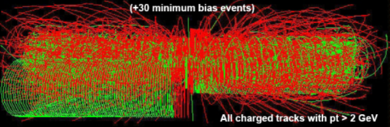
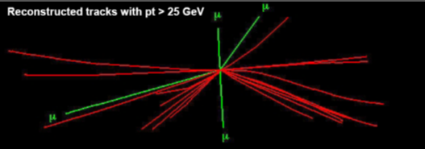

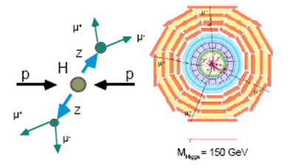
Data Processing and Analysis
RAW Data
Reconstruction
Event Selection
Theory/
Monte Carlo Simulation
Detector Response
Simulation
Calibration/Condition/etc
Data Bases

Slide 19
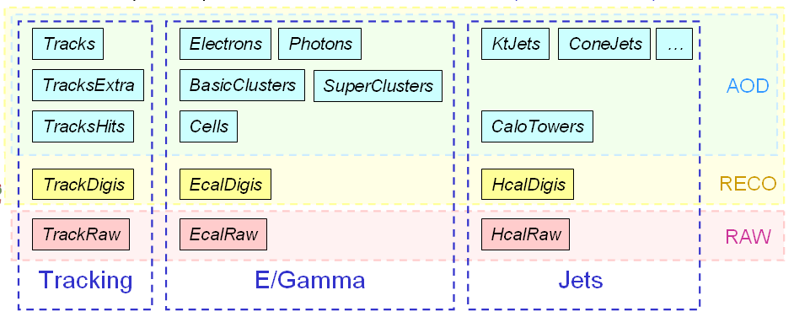
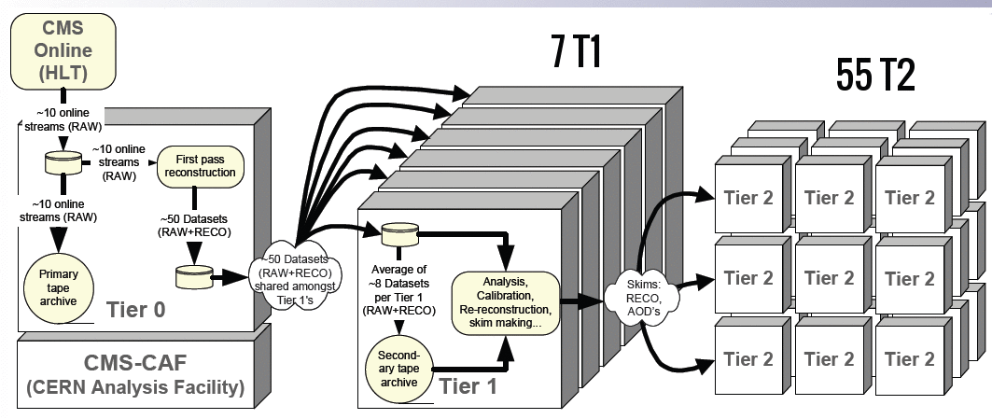
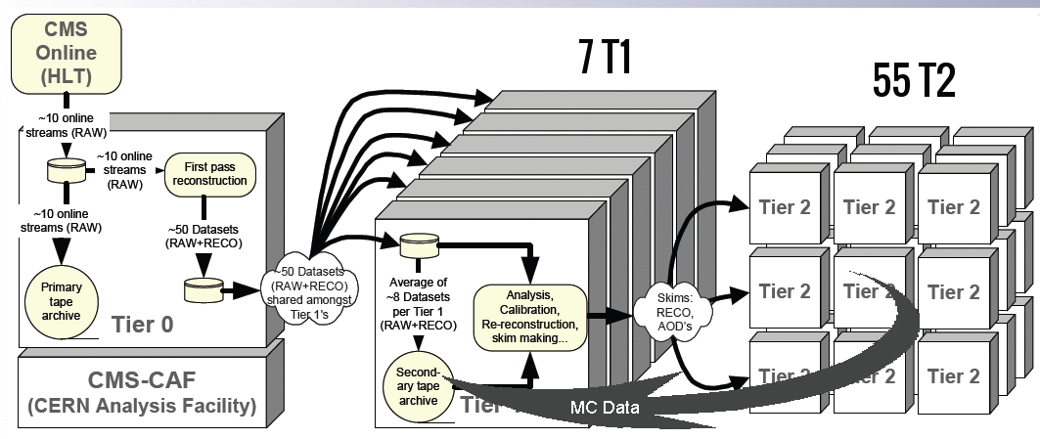
Data Model and Data Flow through Tiers
T0 ⇒ T1
scheduled, time-critical, will be continuous during data-taking periods
reliable transfer needed for fast access to new data, and to ensure that data is stored safely
T1 ⇒ T1:
redistributing data, generally after reprocessing (e.g. processing with improved algorithms)
T1 ⇒ T2:
Data for analysis at Tier-2s

Slide 20
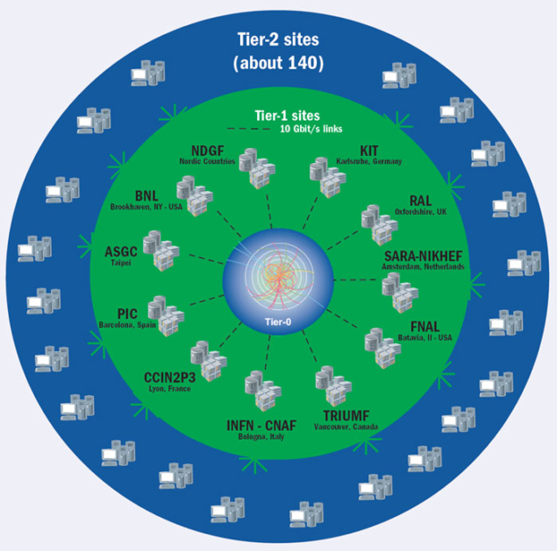
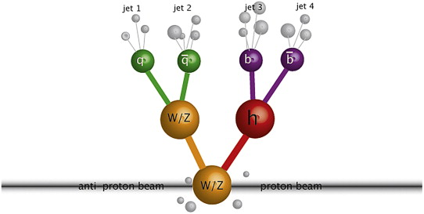
Event Reconstruction
Reconstruction (mathematical methods/algorithms/SW)
physics objects - stable particles (e, μ, γ), clusters of particles (energy), vertexes, etc
unstable particles/ physics processes
Data Processing

Slide 21
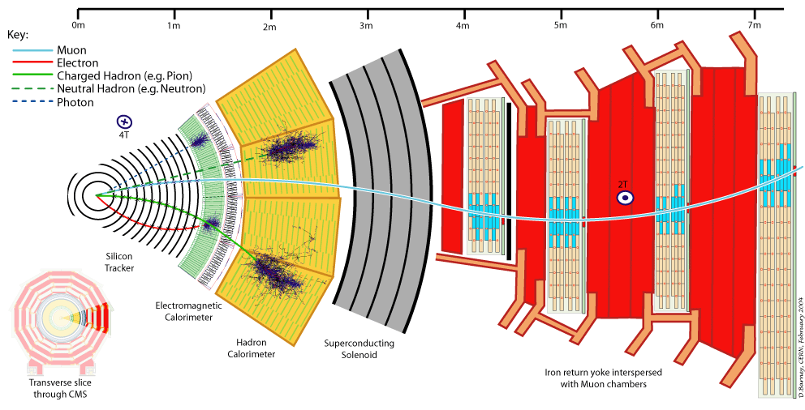
Particles in Detectors
Electromagnetic Calorimeter
Muon Spectrometer
Hadron Calorimeter
Inner Tracker
Magnet
Return flux

Slide 22
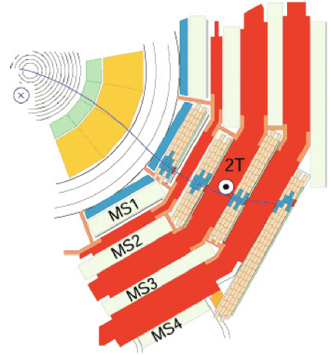




Muon Track and Dumuons Reconstruction
CMS Muon System shows a excellent performance to detect different resonances
Dec 2010
https://twiki.cern.ch/twiki/bin/view/CMSPublic/PhysicsResultsMUO

Slide 23

Jet Finding

Slide 24

Global Event Reconstruction
Using all information of the detector together for optimal measurement

Slide 25




Machine Learning

Slide 26

Example of h → ZZ → 2e 2μ

Slide 27

Example of h → 2γ

Slide 28


Challenge to the Detector/SW (Example)

Slide 29


Data Analysis
Data vs Theory ⇒ which theories you believe vs. reject
Significance of final results ⇒ do you trust your analysis or not?

Slide 30

Data Analysis:
Theory and Modeling (Monte Carlo Simulation)
Three main goals
experiment planning
algorithm's training
data/MC comparison
Digital Twin of Experiments
physics in a collision point
models of detector systems
response from detectors including digitization
processing of MC data (simulation of data flow)

Slide 31

Chain of Simulation
LHE Data
RAW Data
Physics Processes
(Event Generators)
Detector Response
(tracing a particle through matter)
Reconstruction

Slide 32

Theory of Collisions

Slide 33

Event Generators
33

Slide 34



Detector Modeling
GEANT4
34

Slide 35

Data Analysis: Statistics
There are three kinds of lies: lies, damned lies, and statistics (с) Benjamin Disraeli

Slide 36


Significance of Discovery
The probability that an observed excess was a statistical fluctuation of the background (p-value)
Notable values for an excess in particle physics are 3σ, or p-value = 0.0013; and 5σ, or p-value = 2.87 x 10⁻⁷. When we have an excess of 3σ we talk about an evidence, and when we have an excess of 5σ, we are facing a discovery.

Slide 37

… and as a result…

Slide 38

Essential Parts of the Success
Accelerators : powerful machines that accelerate particles to extremely high energies and bring them into collision with other particles
Detectors : gigantic instruments that record the resulting particles as they “stream” out from the point of collision.
Computing : to collect, store, distribute and analyse the vast amount of data produced by these detectors
It's been a global effort, a global success. It has only been possible because of the extraordinary achievements of the experiments, infrastructure and the grid computing“ (c) Rolf Heuer, the Director General of CERN, when the discovery of the Higgs
Collaborative Science on Worldwide scale : thousands of scientists, engineers, technicians and support staff to design, build and operate these complex “machines”.

Slide 39

THANK YOU FOR YOUR ATTENTION!

Slide 40





Physics Objects
Muons (transverse momentum p_{T})
Electrons (energy and tr. momentum p_{T})
Photons (energy)
Jets (energy and coordinates )
…..
Missing energy and p_{T}
vectorial sum of all transverse momentum
Kinematic Variables
Transverse momentum p_{T} (energy)
particles that escape detection have p_{T}=0
total visible p_{T} = 0
p
p_{T}
θ
Longitudinal momentum p_{Z} and energy E_{Z}
particles that escape detection have p_{T}=0
visible p_{Z} is not conserved (not so usefull variable)
Angles
azimuthal and polar angles
polar angle θ is not Lorenz invariant ⇒
rapidity y
or (or m=0) pseudorapidity η
4π-experiments cover
360⁰ over φ and large
pseudorapidity range,
|η| ≤ 5.0 (0.8⁰)

Slide 41

Hit-and-miss Monte Carlo
41

Slide 42





Статистический анализ
Событие (результат) называется “статистическими значимым”, если оно вряд
ли произошло случайно
p-valuе - вероятность получить результат, такой как наблюдается (или выше)
в предположении, что нуль-гипотеза верна
⇒ в нашем случае вероятность, того, что флуктуация фона достигли (или превысили) наблюденное значение
Нуль-гипотеза – основная проверяемая гипотеза (фон)
⇒ Нулевая гипотеза отвергается, когда значение p-value
меньше уровня стат. значимости α (по соглашению <0.05)
Масштабный фактор (strength factor)
σ_{SM} – сечение бозона Хиггса в CM, σ - гипотетическое сечение бозона Хиггса

Slide 43





Story at Higgs Discovery

Slide 44





What does Brazilian Flag mean?
Dimuon example
Extended gauge models
Models of low-energy gravity (RS1-type scenario of ED)
SM predictions
BSM predictions
SM predictions
Mass limit
Model-independent limits on cross section (in narrow width approximation, NWA)

Slide 45




Observation of Gravitational Waves

Slide 46


JINR in Particle Frontiers
JINR LONG-TERM DEVELOPMENT STRATEGIC PLAN UP TO 2030 AND BEYOND
RELATIVISTIC HEAVY-ION PHYSICS AT NICA
JINR PARTICIPATION IN FOREFRONT EXTERNAL EXPERIMENTS OFF-SITE
LHC, SPS, RHIC, and at facilities under construction, as for example the FAIR facility
NICA SPIN PHYSICS
PARTICLE PHYSICS AT THE LHC AND BEYOND
Accelerator-based research and frontier accelerator technologies (LHC, SPS, NICA, FAIR, etc)
Neutrino physics and astroparticle physics (Baikal-GVD, JUNO, NOvA, DUNE, etc)
Multi-messenger astronomy including gravitational wave detection (Baikal-GVD, TAIGA, VIRGO, etc)

Slide 47

What do we know today about the Standard Model from LHC?

